Slide 1

A Hands-on Introduction to Machine Learning
4. Regression

Slide 2
What is supervised learning?
Learning from data when we have correct labels / outcome values
Example: knowing the relationship between size of tumor and cancer (yes/no)
A major area: classification

Slide 3
What we will cover
Linear regression
Multiple linear regression
Lasso and Ridge regression
Gradient descent

Slide 4
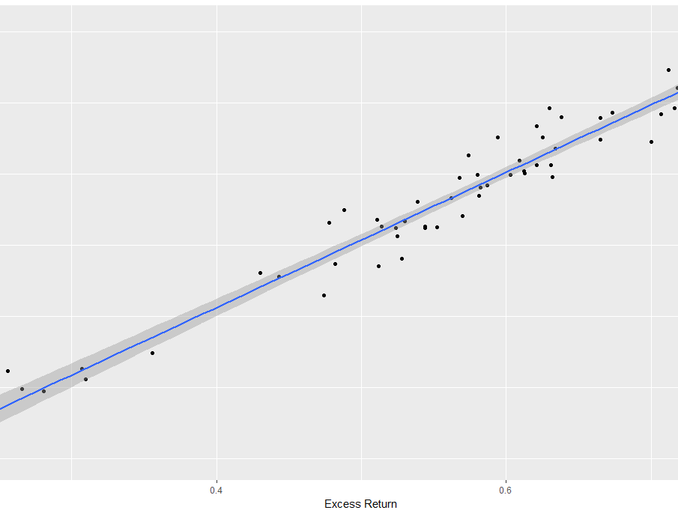
Linear Regression
Example from stock portfolio data showing relationship between annual return and excess return
Linear regression is the process of discovering this line

Slide 5
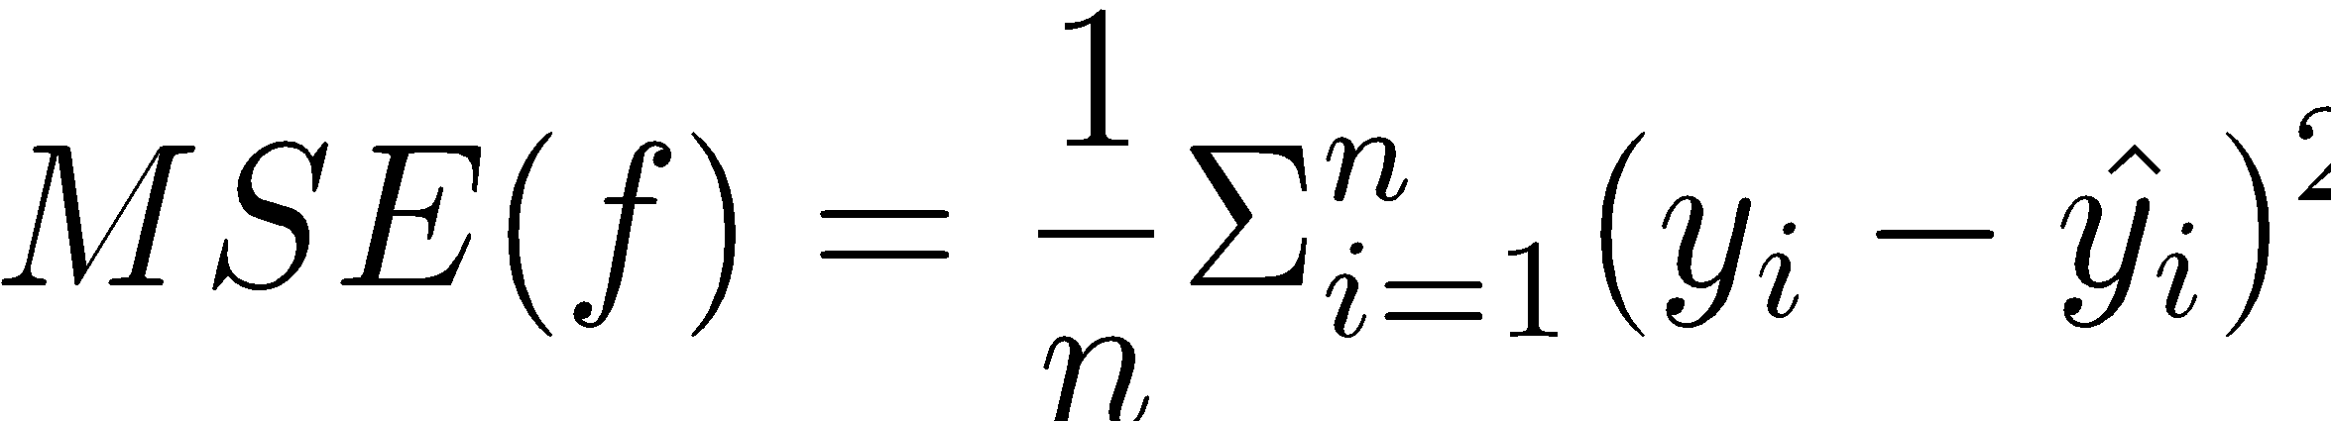
Linear Regression
X = independent variable/predictor
y = dependent variable/outcome
y = c + m*X
c: constant/intercept
m: slope/coefficient
Use OLS (ordinary least squared) method for computing error
For a given (hypothesized) line, find mean square error (MSE):

Slide 6
Multiple Linear Regression
Multiple predictors, single outcome variable

Slide 7


Ridge and Lasso Regression
Large values for parameters in linear regression can be problematic
We can modify the OLS and perform regularization

Slide 8
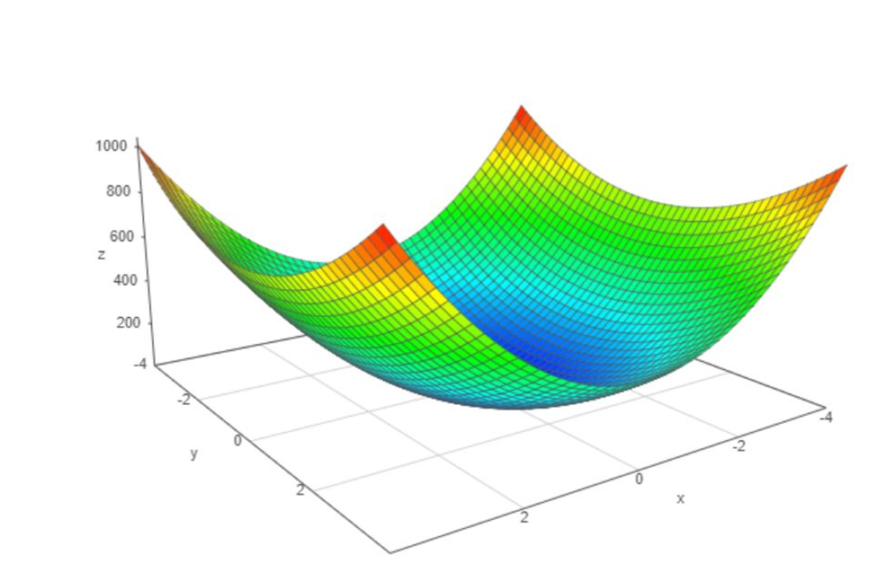
Linear regression using gradient descent
Error surface for various lines created using linear regression (x represents slope, y represents intercept and z is the error value).

Slide 9
Linear regression using gradient descent

Slide 10
Summary
Supervised learning algorithms use a set of examples from previous records that are labeled to make predictions about future.
Two main branches: regression and classification
Regression allows us to establish a linear relationship between predictor(s) and outcome variables.
Ordinary regression may lead to issues of bias, variance, and overfitting. We can address this using regularization, specifically Ridge and Lasso regression methods.
Gradient descent can help us solve regression as well, but it is a lot more robust and generalizable technique that can help us look for solutions in many more situations.

